Slide 1

DEPARTMENT OF COMPUTER SCIENCE AND ENGINEERING UG PROJECT REVIEW II Semester VIII Batch No:09 REAL TIME CREDIT CARD FRAUD DETECTION Domain: Cybersecurity
Team Members Guided By
Venkatesan A-812421104115 Mr. Ramachandran ,AP/CSE
Vignesh A-812421104118
Ajay A-812421104301
Eliyas N-812421104305

Slide 2

INTRODUCTION
E-commerce website where products are stored in a database.
Login confirmation requires OTP verification first.
After OTP verification, face recognition is performed.
Ensures secure, fraud-proof transactions with biometric security.
Reduces risks associated with stolen card details and OTP hacks.

Slide 3
PROBLEM STATEMENT
A multi-layered security approach integrating biometric authentication is needed to prevent unauthorized transactions and real-time fraud in traditional payment systems.

Slide 4
OBJECTIVES
Enhance payment security by implementing Face Recognition
Prevent fraudulent transactions and unauthorized purchases
Ensure a seamless user experience while maintaining strong security
Implement a robust fraud prevention system with real-time checks
Strengthen e-commerce security by reducing identity theft risks

Slide 5
ABSTRACT
Secure Multi-Factor Authentication – Login OTP verification and face recognition to prevent unauthorized transactions.
Grassmann Algorithm for Accuracy – Ensures only the rightful cardholder completes payments by analyzing facial features.
Efficient Technology Stack – Uses Flask, FaceSDK (FSDK), and MySQL for secure and real-time transaction processing.
Fraud Prevention & User Trust – Reduces identity theft and unauthorized access, enhancing e-commerce security and customer confidence.

Slide 6



OVERALL ARCHITECTURE
Admin
Add Product
View Booking
View User Detail
Register user detail with face
User login
User
Grassmann algorithm to compare the face data
OTP Verification
Product purchase
Face Recognition
Make Payment

Slide 7
EXISTING SYSTEM
Most payment systems verify transactions using OTP only
OTP-based authentication is vulnerable to cyber attacks
No biometric verification to confirm user identity
Fraudulent transactions are detected only after they occur
Limited fraud prevention measures in existing e-commerce platforms

Slide 8
PROPOSED SYSTEM
User login OTP verification with Face Recognition for authentication
Uses the Grassmann Algorithm to analyze and verify facial features
Ensures only the rightful owner can complete transactions
Provides a secure and reliable fraud prevention system
Strengthens payment security with multi-factor authentication

Slide 9
TOOLS DESCRIPTION
Frontend Technologies: HTML, CSS, JavaScript – Used for designing the e-commerce website and creating an interactive user interface.
Backend Framework: Flask (Python) – Handles authentication, transaction processing, and face recognition integration.
Database Management: MySQL – Stores user details, transaction history, and facial recognition data securely.
Face Recognition Library: FSDK & Grassmann Algorithm – Captures, processes, and verifies facial features for authentication.

Slide 10
ALGORITHM AND METHOD DESCRIPTION
OpenCV (Open Source Computer Vision Library)
Face Detection: OpenCV uses algorithms like Haar Cascade detector to locate faces in images or video streams.
Image Preprocessing: It prepares images for facial recognition by resizing, converting to grayscale and reducing noise.
Integration with SDKs: OpenCV seamlessly integrates with tools like FaceSDK, feeding cleaned and aligned face data for accurate feature extraction.
Lightweight and Fast: OpenCV is open source, highly optimized in C/C++, and supported in Python, making it efficient for deployment in real-time applications.

Slide 11
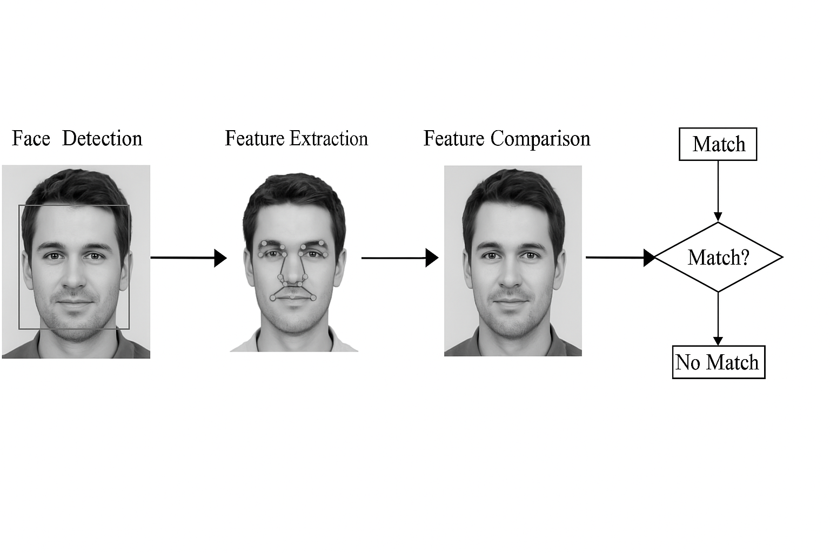

Slide 12
ALGORITHM AND METHOD DESCRIPTION
FaceSDK(FSDK)
Facial Landmark Detection: FaceSDK identifies key facial points (e.g., eyes, nose, mouth) to accurately map the user's face.
Feature Extraction: It converts the facial landmarks into a biometric feature vector (template), which is stored in a .dat file.
Real-Time Face Recognition: During authentication, FSDK compares live face data with the stored template in real time for instant verification.
High Accuracy and Speed: Optimized for performance, it provides reliable results even with minor variations in lighting, pose, or facial expressions.

Slide 13
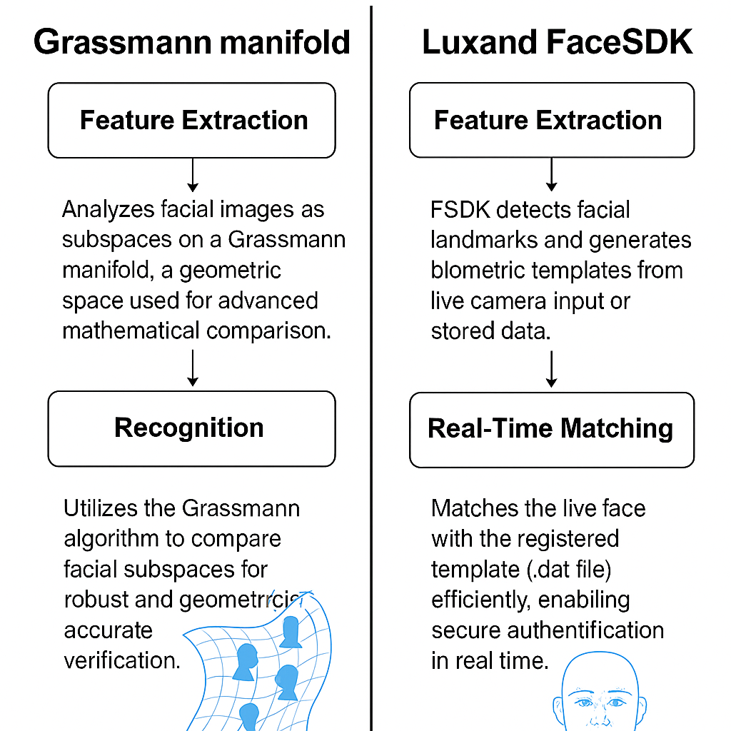

Slide 14
ALGORITHM AND METHOD DESCRIPTION
Grassmann Algorithm
Subspace Representation: It face image of a person as a subspace, capturing variations in lighting, pose, and expression.
Manifold-Based Matching: Compares facial subspaces as points on a Grassmann manifold, using geometric distances rather than raw feature vectors.
Improved Accuracy: Offers higher recognition precision than traditional methods by analyzing face patterns in a multi-dimensional space.
Robust to Variations: More resilient to real-world conditions, such as changes in camera angles or facial expressions.

Slide 15
ALGORITHM AND METHOD DESCRIPTION
Grassmann Algorithm
Features Used in Grassmann-Based Subspace Matching
Facial Landmark Features
These are key points on the face detected by tools like FaceSDK or Dlib:
Eyes (inner & outer corners)
Eyebrows
Nose tip & base
Mouth corners
Jawline
These landmarks are turned into numerical coordinates (x, y) used for analysis.

Slide 16
ALGORITHM AND METHOD DESCRIPTION
Grassmann Algorithm
2. Facial Feature Vectors
Each image is converted into a feature vector (e.g., 128 ).
These vectors represent the shape and structure of the face.
3. Multiple Samples as a Subspace
Rather than using a single image, several face vectors of the same user (from different angles, lighting, expressions) are grouped.
These vectors span a low-dimensional subspace (e.g., 3D ).
This subspace becomes a "point" on the Grassmann manifold.

Slide 17
ALGORITHM AND METHOD DESCRIPTION
Grassmann Algorithm
4. Subspace Basis Matrix
This is a matrix representation of the subspace derived using techniques like PCA (Principal Component Analysis).
The matrix holds the principal components (eigenvectors) of the face data set.
5. Geodesic Distance Between Subspaces
The Grassmann algorithm calculates the geodesic distance between:
The live face subspace
The stored (registered) face subspace
Smaller distances = higher match probability.

Slide 18
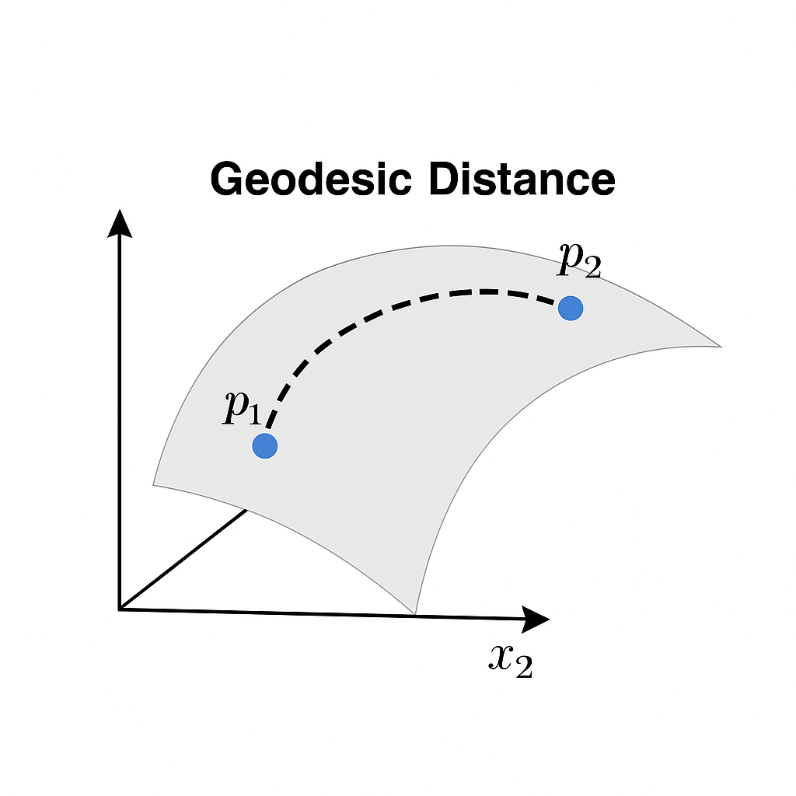

Slide 19
ALGORITHM AND METHOD DESCRIPTION
Grassmann Algorithm
PCA (Principal Component Analysis)
Face images are usually high-dimensional (e.g., 100x100 pixels = 10,000 values).
Not all of these values are useful — many are redundant or noisy.
PCA transforms this high-dimensional data into a smaller set of values (called principal components) that still represent the essential face features.

Slide 20
ALGORITHM AND METHOD DESCRIPTION
Grassmann Algorithm
Eigenvectors
An eigenvector is a special type of vector in linear algebra.
When you multiply a matrix by one of its eigenvectors, the result is just a scaled version of that eigenvector.
They represent patterns in faces:
Another might represent the distance between eyes.
Another might capture nose width.

Slide 21
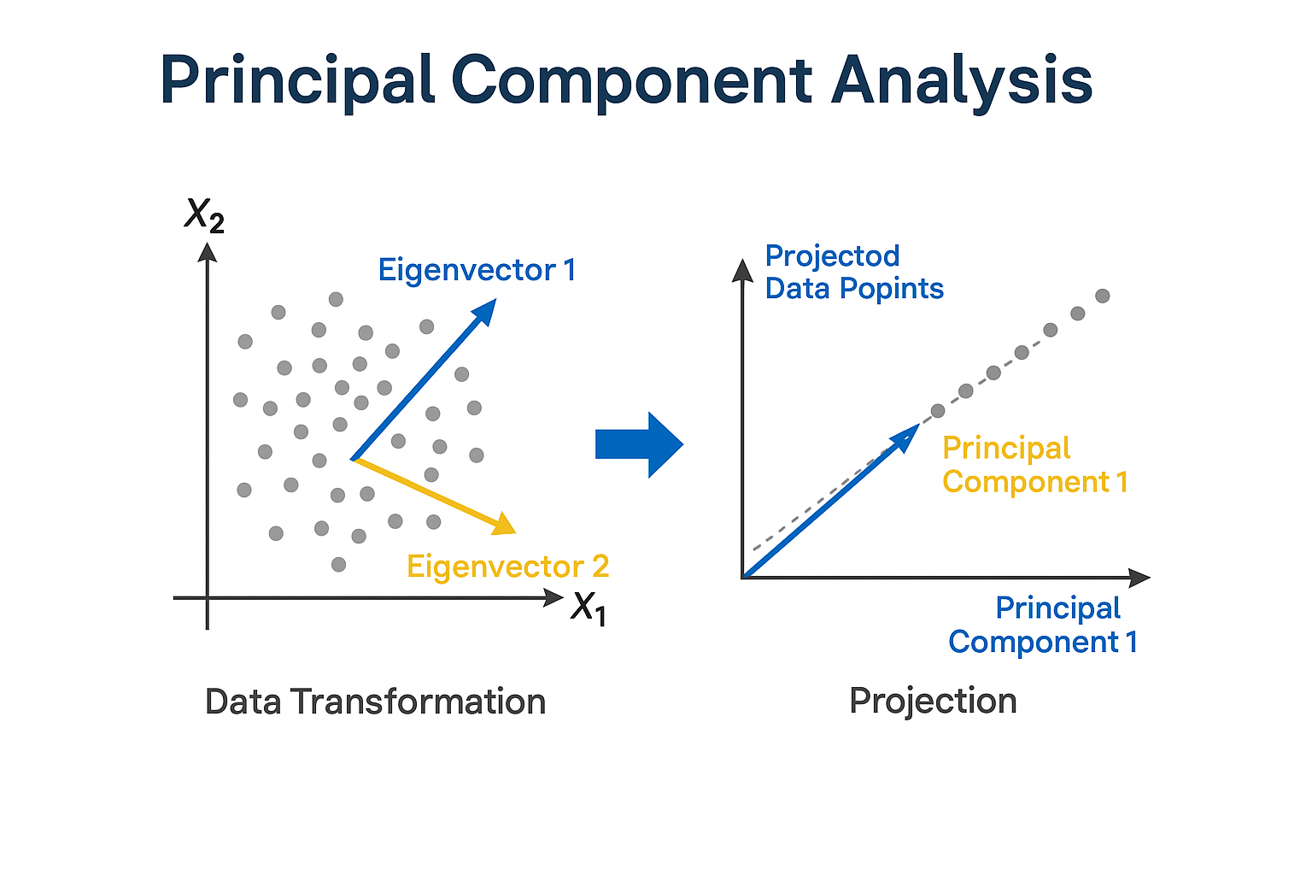

Slide 22
ALGORITHM AND METHOD DESCRIPTION
Liveness Detection
Anti-Spoofing Mechanism: Differentiates between a real human face and fake media (e.g., photos, videos, masks) using movement and texture cues.
Motion-Based Techniques: Detects eye blinks, head turns, or facial expressions in real time to confirm that the subject is live.
Texture & Depth Analysis: Uses surface texture patterns and 3D depth sensing to identify flat or artificial surfaces used in spoof attacks.
Real-Time Detection: Performs liveness checks during the authentication phase without delaying the user's experience.

Slide 23
LIST OF MODULES
Admin
User
Product Purchase
Face Recognize
Make Payment

Slide 24
MODULE DESCRIPTION
ADMIN
Login: Admin logs in using a username and password.
Add Employee/Product: Admin adds employee and product details.
View Booking Details: Admin/employee views user booking information.
View User Details: Admin accesses user information like name, email, and contact details.

Slide 25
MODULE DESCRIPTION
USER
Register: Users create an account by providing required details.
Login: Users log in using a username and password and OTP for User Verification.
Product Purchase: Users browse, view, and buy products, with purchase details sent to the admin.

Slide 26
MODULE DESCRIPTION
Payment & Authentication Module
Face Recognition: Captures and verifies the user’s face; if matched, payment is approved; if not, it is denied.

Slide 27

SCREENSHOTS
Home page

Slide 28
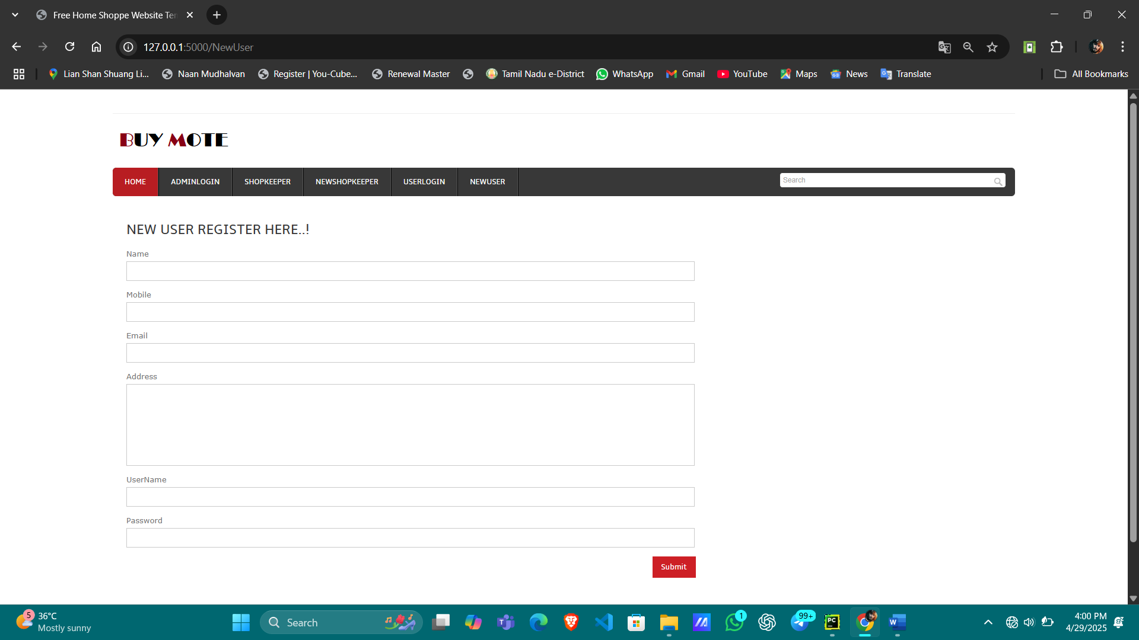
SCREENSHOTS
New user registration

Slide 29
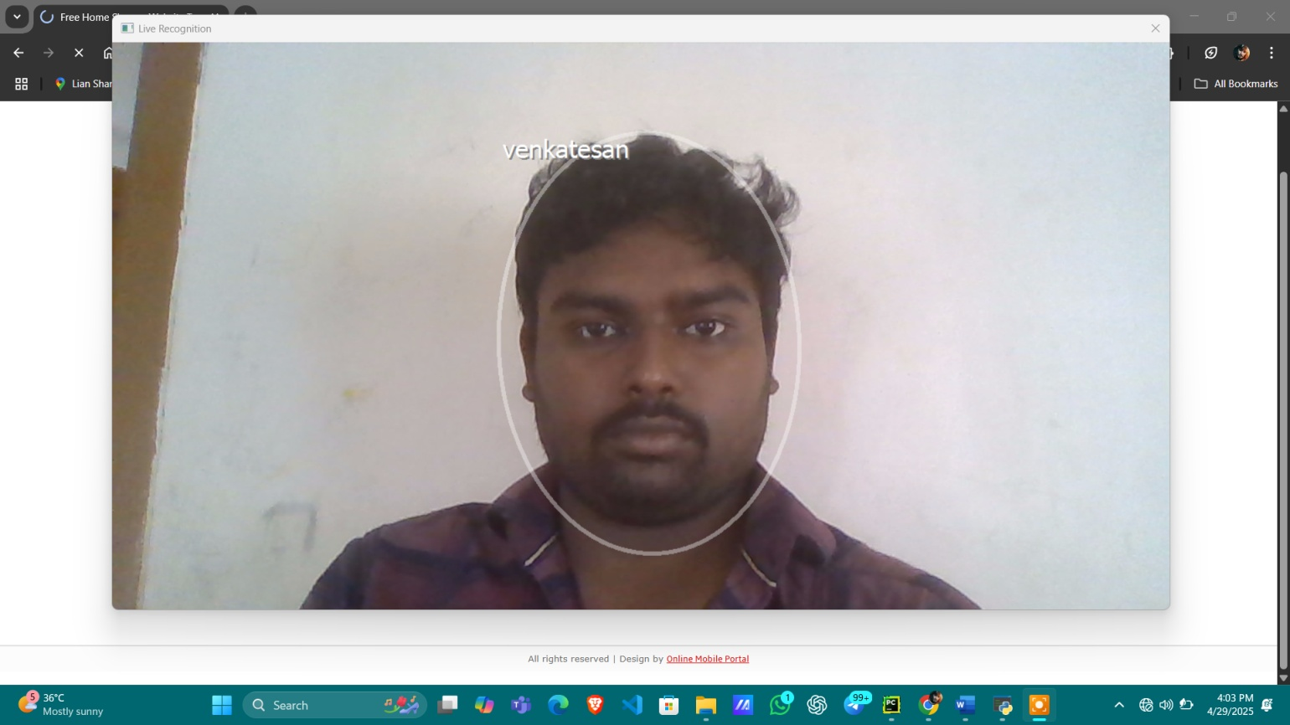
SCREENSHOTS
New user face live recognition

Slide 30
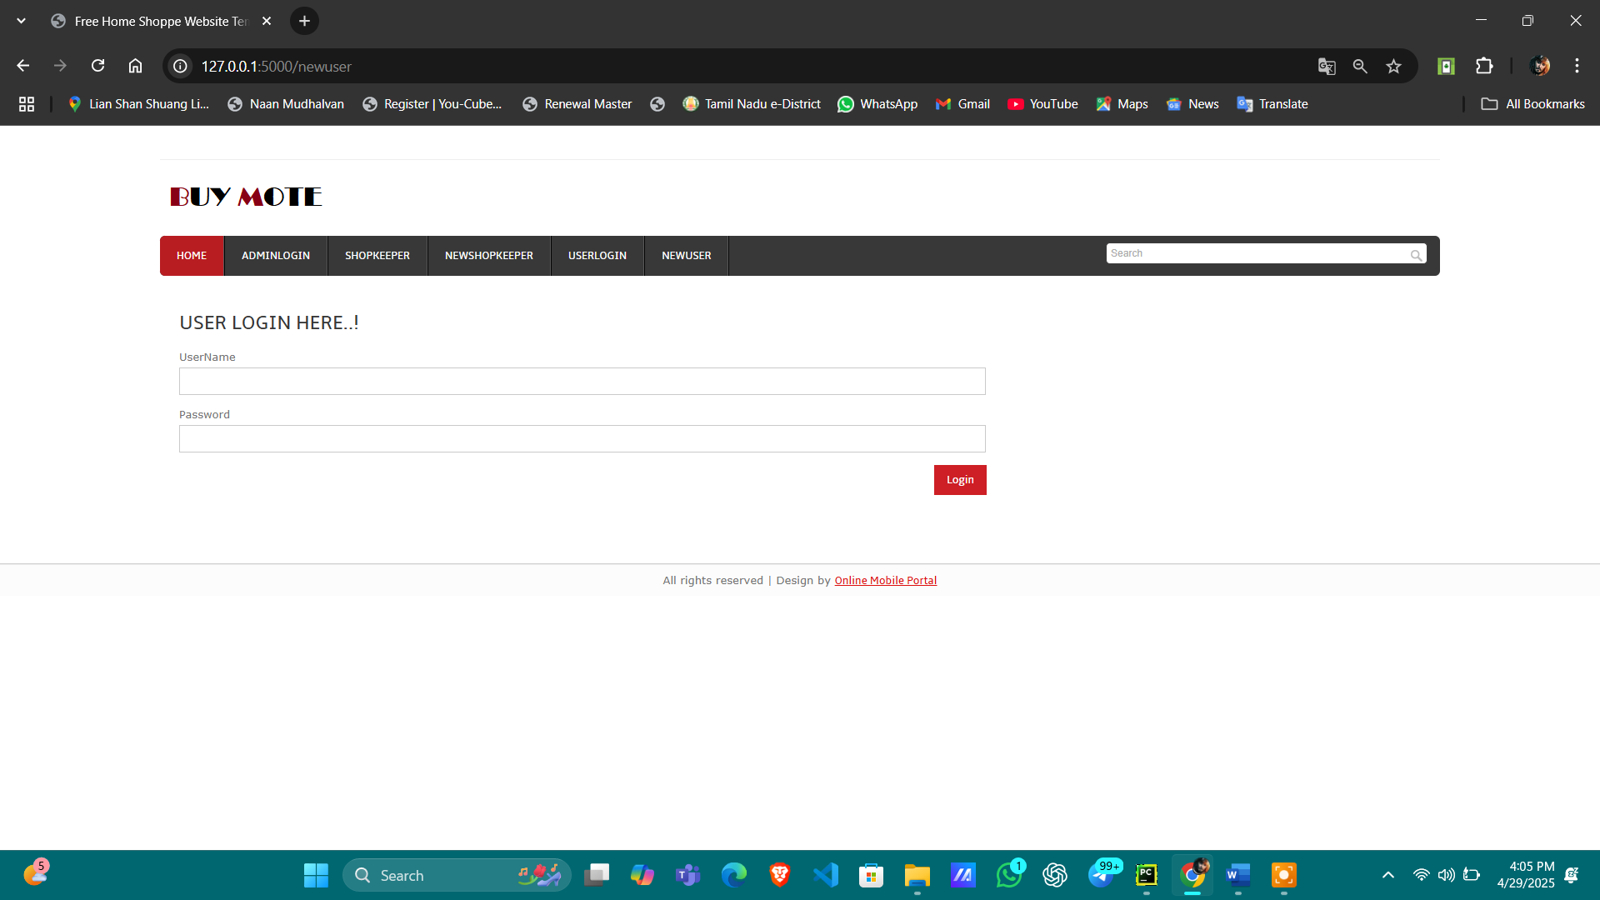
SCREENSHOTS
User login

Slide 31
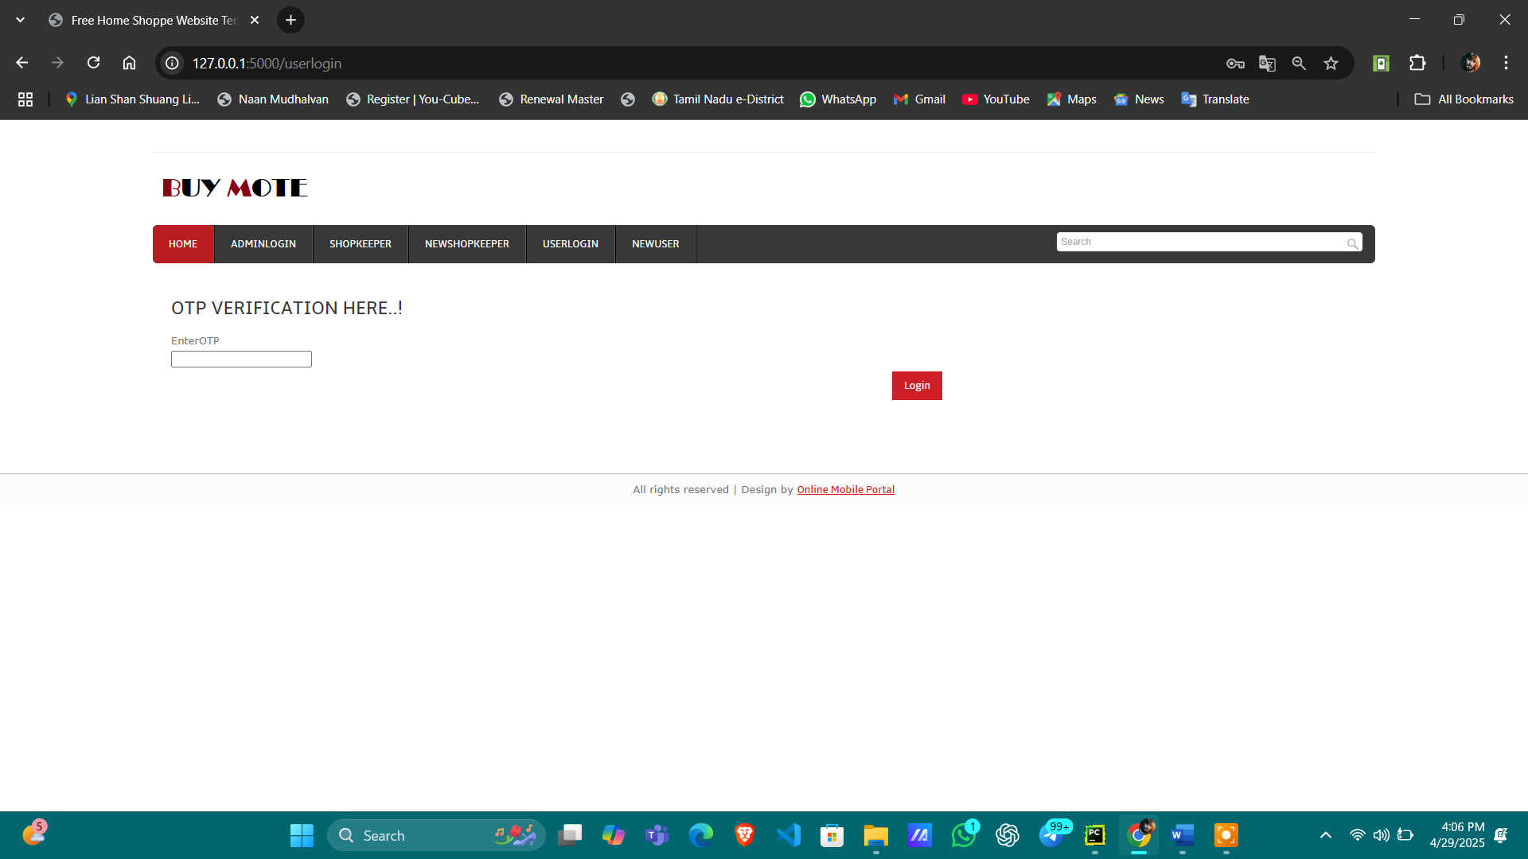
SCREENSHOTS
OTP verification for login process

Slide 32
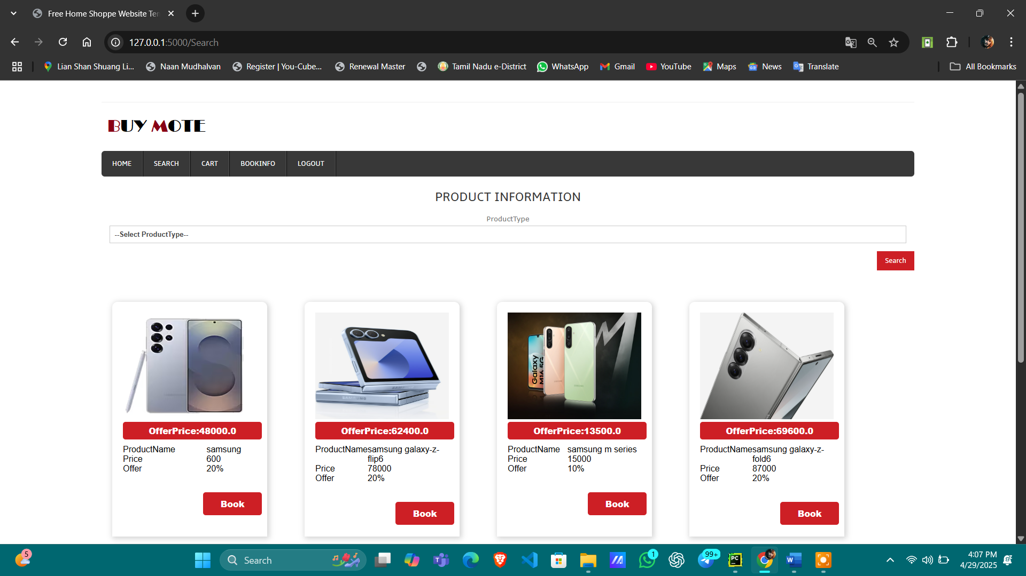
SCREENSHOTS
Searching page

Slide 33
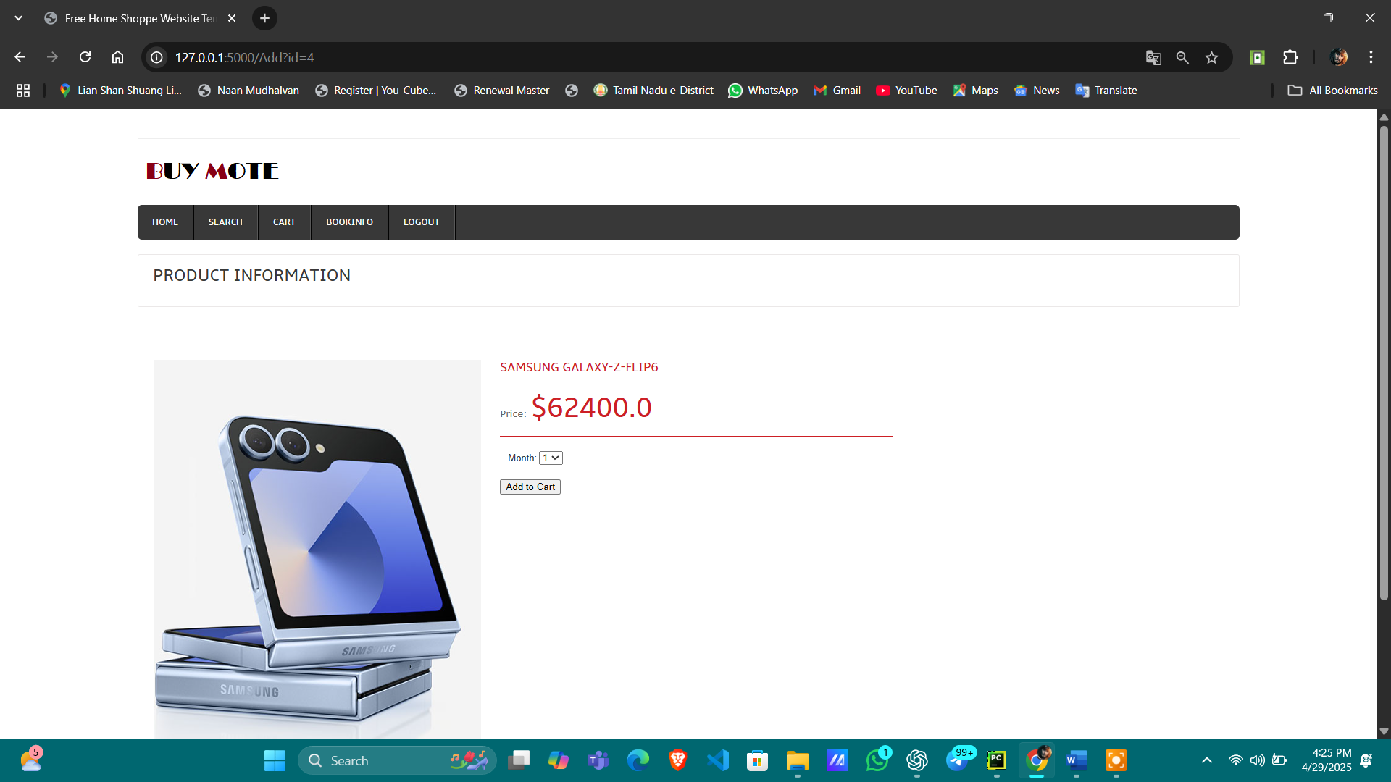
SCREENSHOTS
Cart page

Slide 34
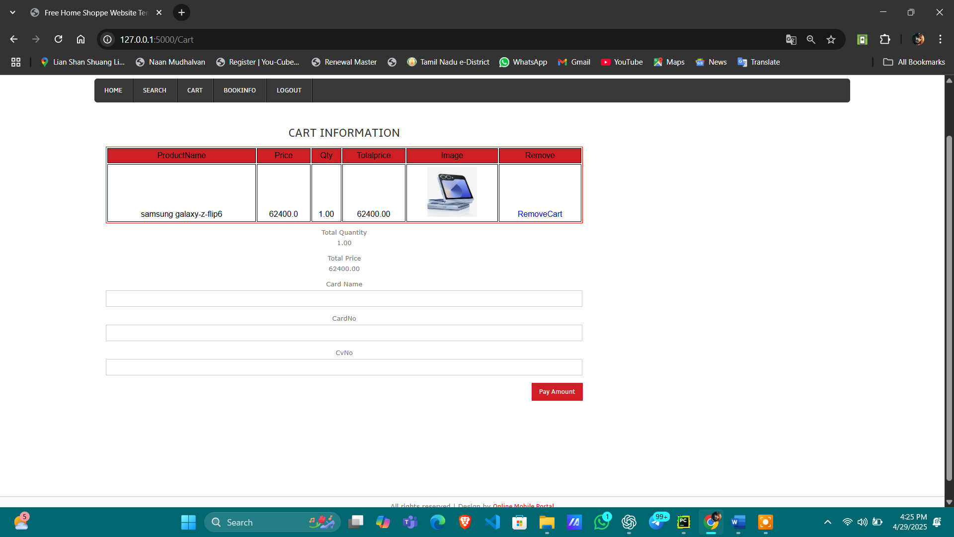
SCREENSHOTS
Credit card information page

Slide 35
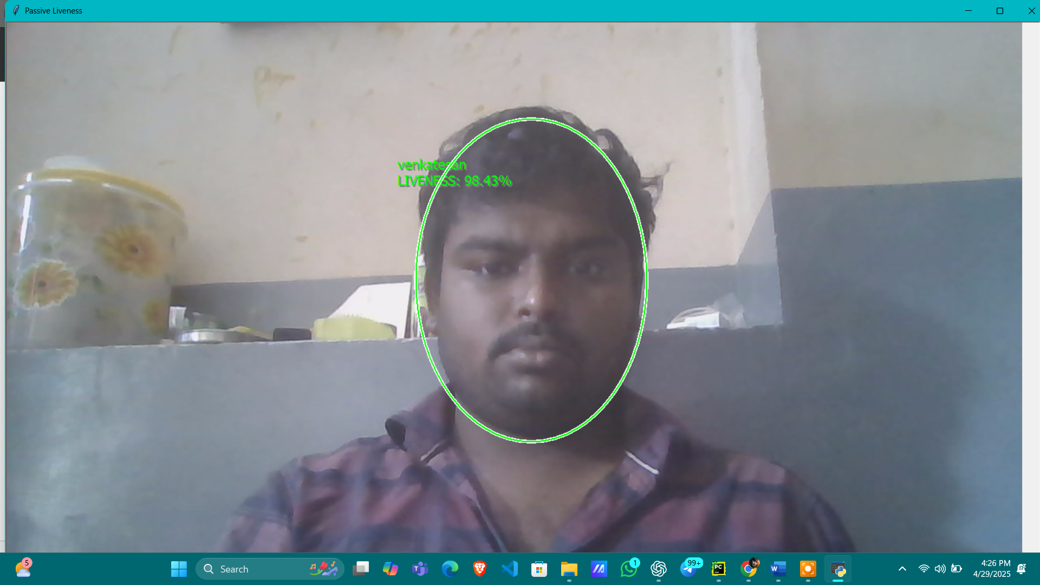
SCREENSHOTS
Face recognition page

Slide 36
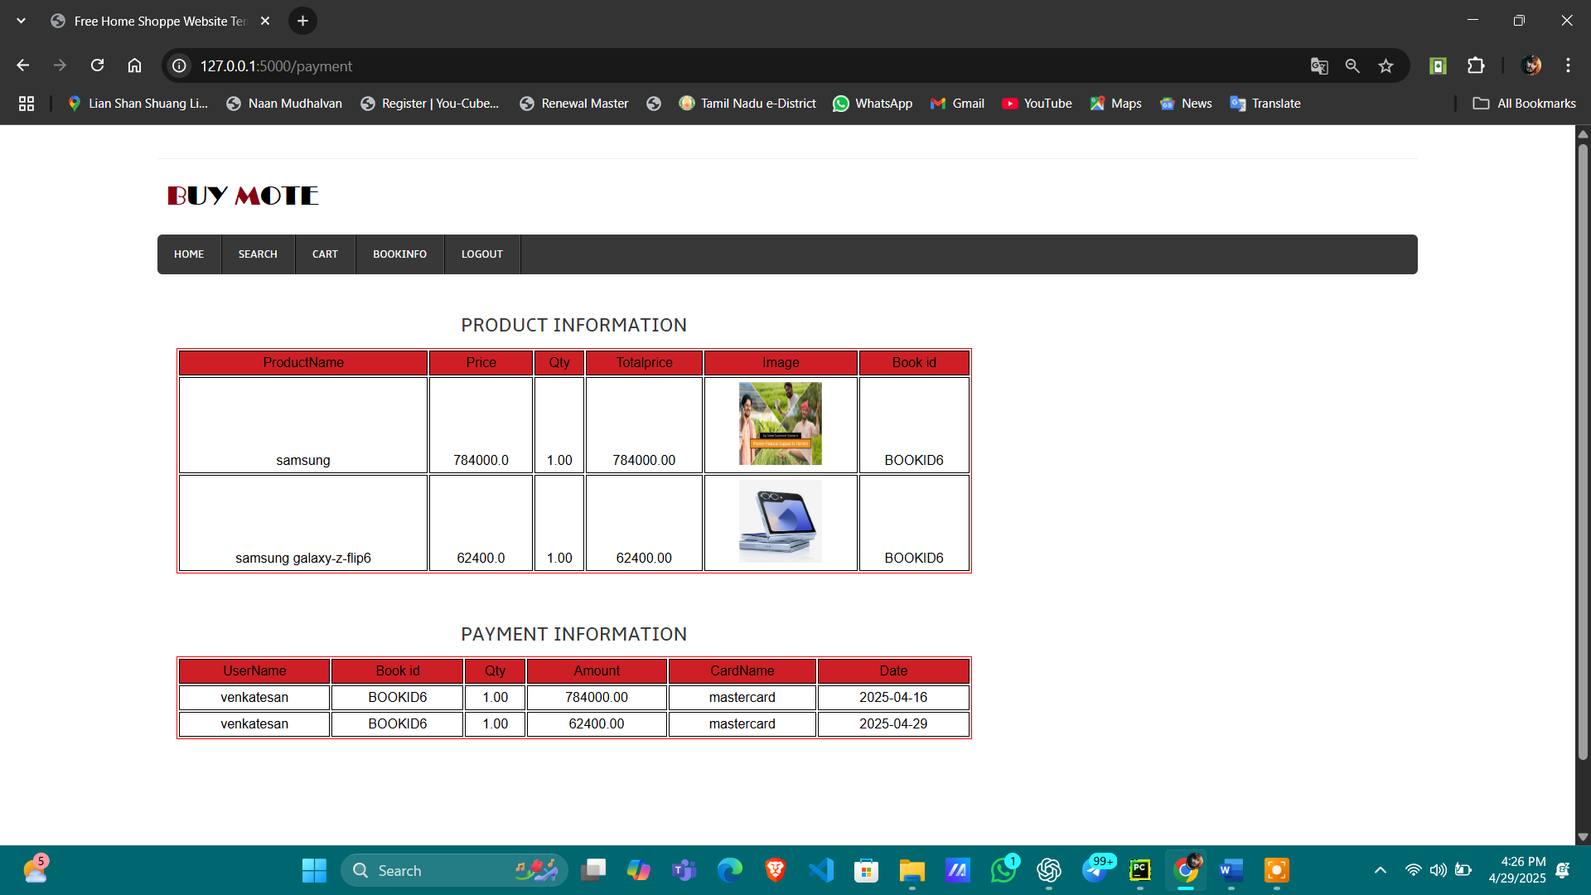
SCREENSHOTS
Payment Success page

Slide 37
LIST OF REFERENCES
Sahu, Aanchal, G. M. Harshvardhan, and Mahendra Kumar Gourisaria. "A dualapproach forcreditcardfrauddetectionusingneuralnetworkanddataminingtechniques."In 2020IEEE 17th India council international conference (INDICON), pp. 1-7.IEEE, 2020.
Panda, Agyan, BharathYadlapalli, and Zhi Zhou. "Credit card fraud detection through machine learning algorithm." Big Data and Computing Visions 1, no. 3 (2021): 140-145.
Aziz,Amir,andHamidGhous."FraudulentTransactionsDetectioninCreditCardbyusing Data Mining Methods: A Review." INTERNATIONAL JOURNAL OF SCIENTIFIC PROGRESS AND RESEARCH (IJSPR) 79, no. 179 (2021).
Shah, Ankit, and Akash Mehta. "Comparative Study of Machine Learning Based ClassificationTechniquesforCredit CardFraudDetection."In2021InternationalConference on Data Analytics for Business and Industry (ICDABI), pp. 53-59.IEEE, 2021.

Slide 38
LIST OF REFERENCES
Mienye, IbomoiyeDomor, and NobertJere. "Deep learning for credit cardfraud detection: A review of algorithms, challenges, and solutions."IEEE Access (2024).
Singh, Gurpreet,DivyanshiKaushik, HritikHanda, GagandeepKaur, SunilKumar Chawla, and A. Ahmed. "BioPay: a secure payment gateway through biometrics." Journal of Cybersecurity and Information Management 7, no. 2 (2021): 65-76.
Tiwari, Pooja, Simran Mehta, NishthaSakhuja, Jitendra Kumar, and Ashutosh Kumar Singh. "Credit card fraud detection using machine learning: a study." arXiv preprint arXiv:2108.10005 (2021).
Kumar,Sheo,VinitKumarGunjan,MohdDilshadAnsari,andRashmiPathak."CreditCard Fraud Detection Using Support Vector Machine." In Proceedings of the 2nd International Conference on Recent Trends in Machine Learning, IoT, Smart Cities and Applications: ICMISC 2021, pp. 27-37. Springer Singapore, 2022.

Slide 39
LIST OF REFERENCES
1. OpenCV (Face Detection and Preprocessing)
Singh, D. and Singh, M., 2020. Investigation of OpenCV for real-time face detection using Haar features. International Journal of Computer Applications, 975:8887. DOI: 10.5120/ijca2020919985
2. FaceSDK (Feature Extraction and Recognition)
Hjelmås, E. and Low, B.K., 2001. Face detection: A survey. Computer Vision and Image Understanding, 83(3), pp.236–274. DOI: 10.1006/cviu.2001.0921
3. Grassmann Algorithm (Subspace Learning and Face Matching)
Hamm, J. and Lee, D.D., 2008. Grassmann discriminant analysis: a unifying view on subspace-based learning. In Advances in Neural Information Processing Systems, 21.

Slide 40
LIST OF REFERENCES
4. Liveness Detection (Anti-Spoofing in Face Biometrics)
Määttä, J., Hadid, A., and Pietikäinen, M., 2011. Face spoofing detection from single images using micro-texture analysis. IEEE International Joint Conference on Biometrics (IJCB), pp.1-7. DOI: 10.1109/IJCB.2011.6117510
5. .dat File (Biometric Template Storage)
Jain, A.K., Ross, A. and Nandakumar, K., 2011. Introduction to biometrics. Springer Science & Business Media. ISBN: 978-0-387-77326-1 (Discusses secure biometric template formats, including binary file storage such as .dat

